Slide 1
Container Orchestration
Kubernetes

Slide 2
Faculty
Ashok Pon Kumar (ashokponkumar@in.ibm.com) – IBM Research
Mudit Verma (mudiverm@in.ibm.com) – IBM Research

Slide 3
Agenda
Topic | Time | Duration
Container Orchestration Kubernetes History of Kubernetes Basic Kubernetes concepts | 10:45-11:45 AM | 1 hour
Lab - Setting up the cluster | 11:45 AM -12:30 PM | 45 mins
Lunch | 12:30 - 1:30 PM | 1 Hour
Lab - Bringing up a single service | 1:30 - 2:15 PM | 45 mins
Advanced Kubernetes Concepts | 2:15 - 3:15 PM | 1 Hour
Lab - Bringing up a multi service application | 3:15 - 5:00 PM | 1.5 Hour 15 min break
Service Mesh | 5:00-6:00 PM | 1 Hour

Slide 4
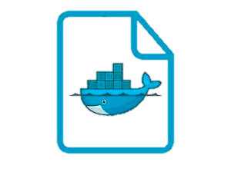
Containers
Containers are an executable unit of software in which application code is packaged, along with its libraries and dependencies, so that it can be run anywhere, whether it be on desktop, traditional IT, or the cloud.
Container Image
A read-only snapshot of a container. You use an image as a template for building containers.
Container Instance
The standard unit where the application service is located. It can be considered as a running container image.
Container Registry
The registry stores, distributes, and shares container images. It is available in software as a service (SaaS) or in an enterprise to deploy anywhere.
Container Runtime
A program that runs application containers. It runs on a physical or virtual machine.
Dockerfile
An entity that stores a simple, descriptive set of instructions. It gets built into a container image.

Slide 5
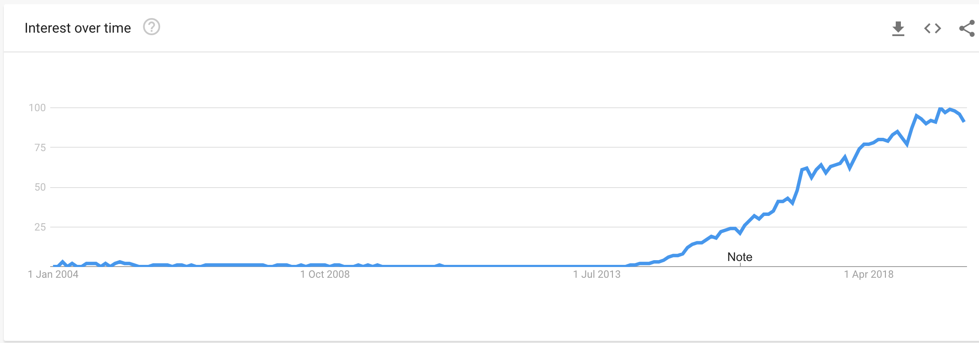
Rise of microservices
Microservices @ Google Trends

Slide 6
Why container orchestration?
Each enterprise application is composed of numerous microservices.
Each microservice needs to scale independently.
Applications should seamlessly run across multiple nodes/machines.
Inter microservice communication needs management.
Each microservice needs to be maintained healthy.

Slide 7
Container Orchestration
Container orchestration manages the deployment, placement, and lifecycle of containers.
It also has many other responsibilities:
Cluster management federates hosts into one target.
Schedule management distributes containers across nodes through the scheduler.
Service discovery knows where containers are located and distributes client requests across them.
Replication ensures that the right number of nodes and containers are available for the requested workload.
Health management detects and replaces unhealthy containers and nodes.

Slide 8
Container Orchestrators
Kubernetes
Docker Swarm
… and a lot more

Slide 9
Kubernetes
The Kubernetes platform for big ideas

Slide 10
Kubernetes Timeline
2003-2004: Borg System
Started as an internal Google project.
2014:
Kubernetes launches as an opensource project.
2015:
First Kubecon conference.
Openshift 3.0 released
2016:
Helm, Minikube released.
Pokémon GO – Largest Kubernetes deployment till 2016
2017:
IBM and Google announce Istio
2018:
Most cloud providers
start supporting
managed Kubernetes
2019:
Kubecon NA 2019 has 12000+ attendees.
CNCF has 500+ members.
Kubernetes
Kube
K8
Cloud Native Computing Foundation (CNCF)
Openshift
OCP

Slide 11
Cluster
A cluster is a set of Nodes that run containerized applications managed by Kubernetes.

Slide 12
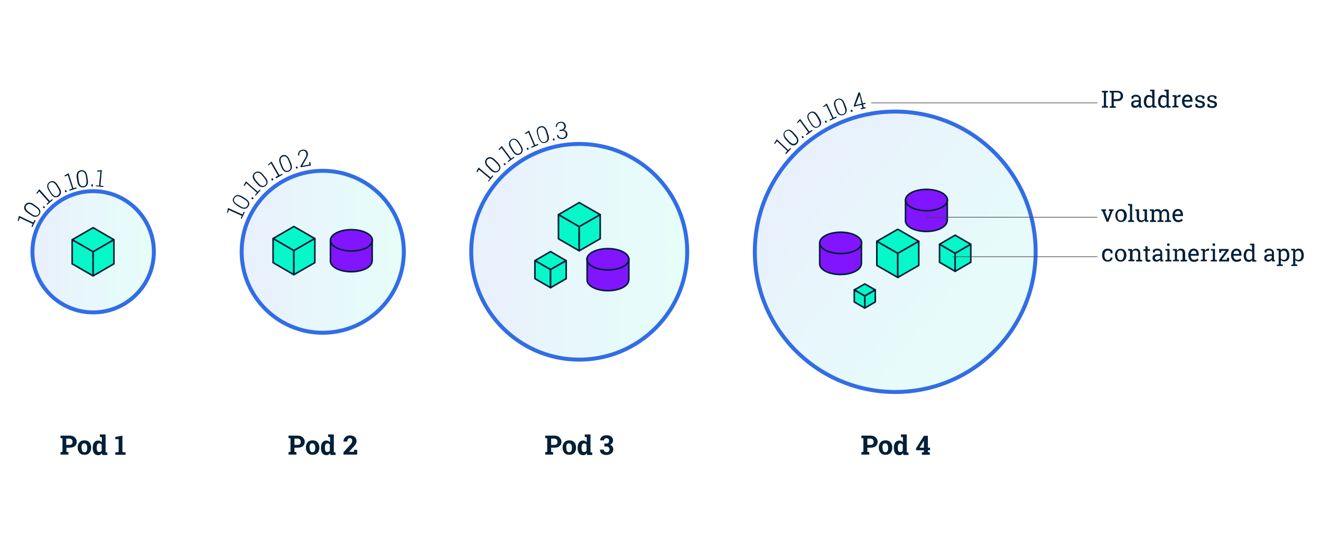
Pod
A Pod runs containers. Each Pod has its own IP address and shares a PID namespace, network, and host name.

Slide 13
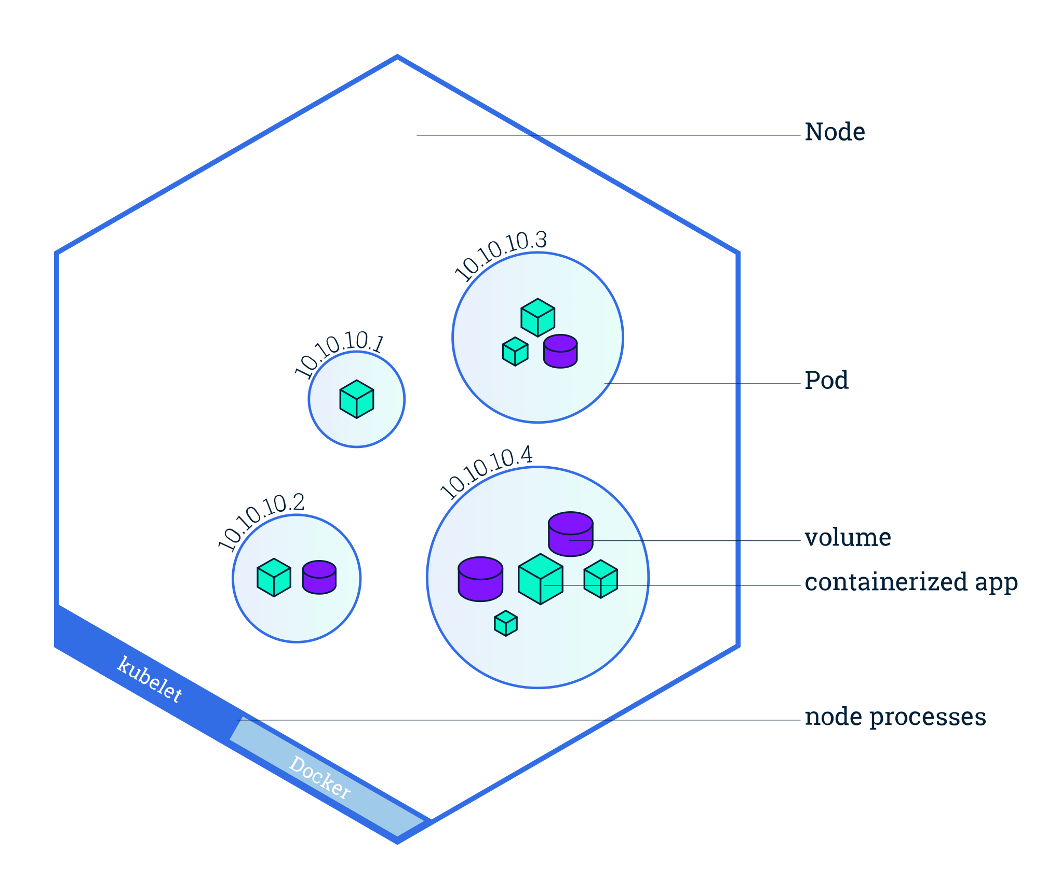
Node
A node is a worker machine in Kubernetes. A node may be a VM or physical machine, depending on the cluster.

Slide 14
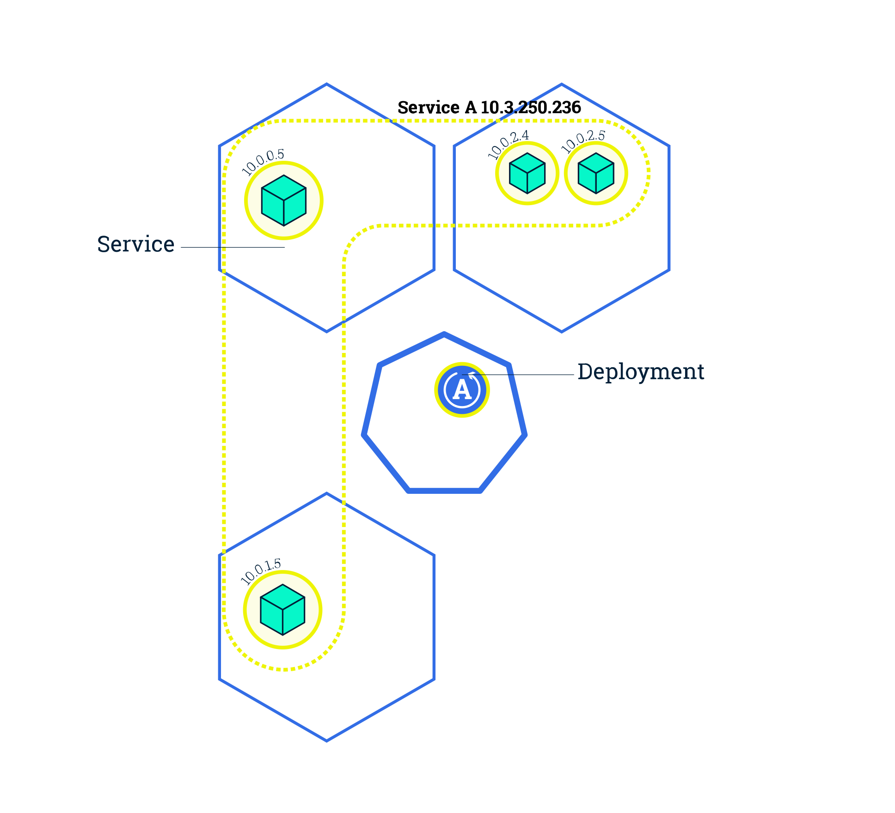
Deployment and Service
A Deployment provides declarative updates for Pods.
A Service is a collection of Pods that is exposed as an endpoint.

Slide 15
Ingress
Ingress manages external access to the services in a cluster, typically HTTP.

Slide 16
.. As Code
apiVersion: apps/v1
kind: Deployment
metadata:
name: nginx-deployment
labels:
app: nginx
spec:
replicas: 3
selector:
matchLabels:
app: nginx
template:
metadata:
labels:
app: nginx
spec:
containers:
- name: nginx
image: nginx:1.7.9
ports:
- containerPort: 80
Uses declarative model rather than event-based model
Yaml files to define all configurations

Slide 17
Advanced

Slide 18
Storage in Kubernetes
All data stored inside a container instance is transient
Persistent Volume Claims (PVC) and Persistent Volumes (PV)
PVCs are identified by name, and a single PVC can be mounted into many pods.
In most managed clouds, PVs can be dynamically provisioned.

Slide 19
ConfigMaps
.. As Environment variables
apiVersion: v1
kind: ConfigMap
metadata:
name: special-config
namespace: default
data:
SPECIAL_LEVEL: very
SPECIAL_TYPE: charm
apiVersion: v1
kind: Pod
metadata:
name: dapi-test-pod
spec:
containers:
- name: test-container
image: k8s.gcr.io/busybox
command: [ "/bin/sh", "-c", "env" ]
envFrom:
- configMapRef:
name: special-config
restartPolicy: Never

Slide 20
Health check
Liveliness probes to check if the application is alive or dead.
Readiness probes to ensure the application is ready to accept traffic.
readinessProbe:
httpGet:
path: /healthz
port: liveness-port
failureThreshold: 1
periodSeconds: 10
livenessProbe:
httpGet:
path: /healthz
port: liveness-port
failureThreshold: 1
periodSeconds: 10

Slide 21
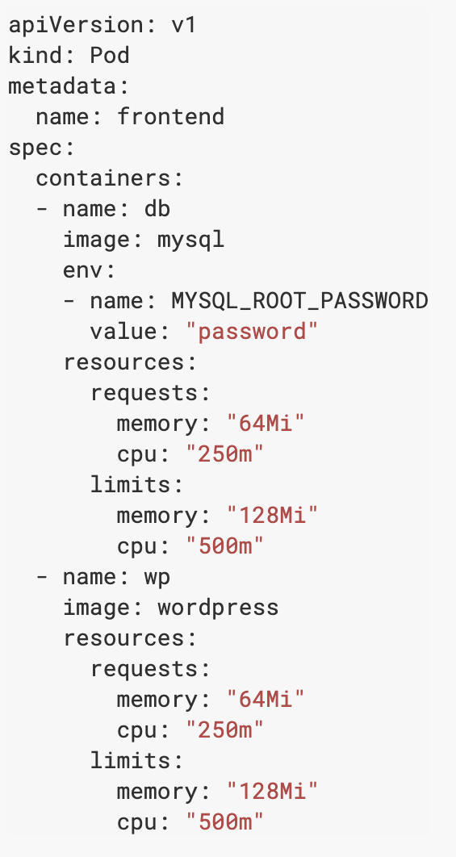
Resources
Requests and limits
CPU and memory
spec.containers[].resources.limits.cpu
spec.containers[].resources.limits.memory
spec.containers[].resources.requests.cpu
spec.containers[].resources.requests.memory

Slide 22
Autoscalers
Cluster Autoscaler
Horizontal Pod Autoscaler
Vertical Pod Autoscaler

Slide 23
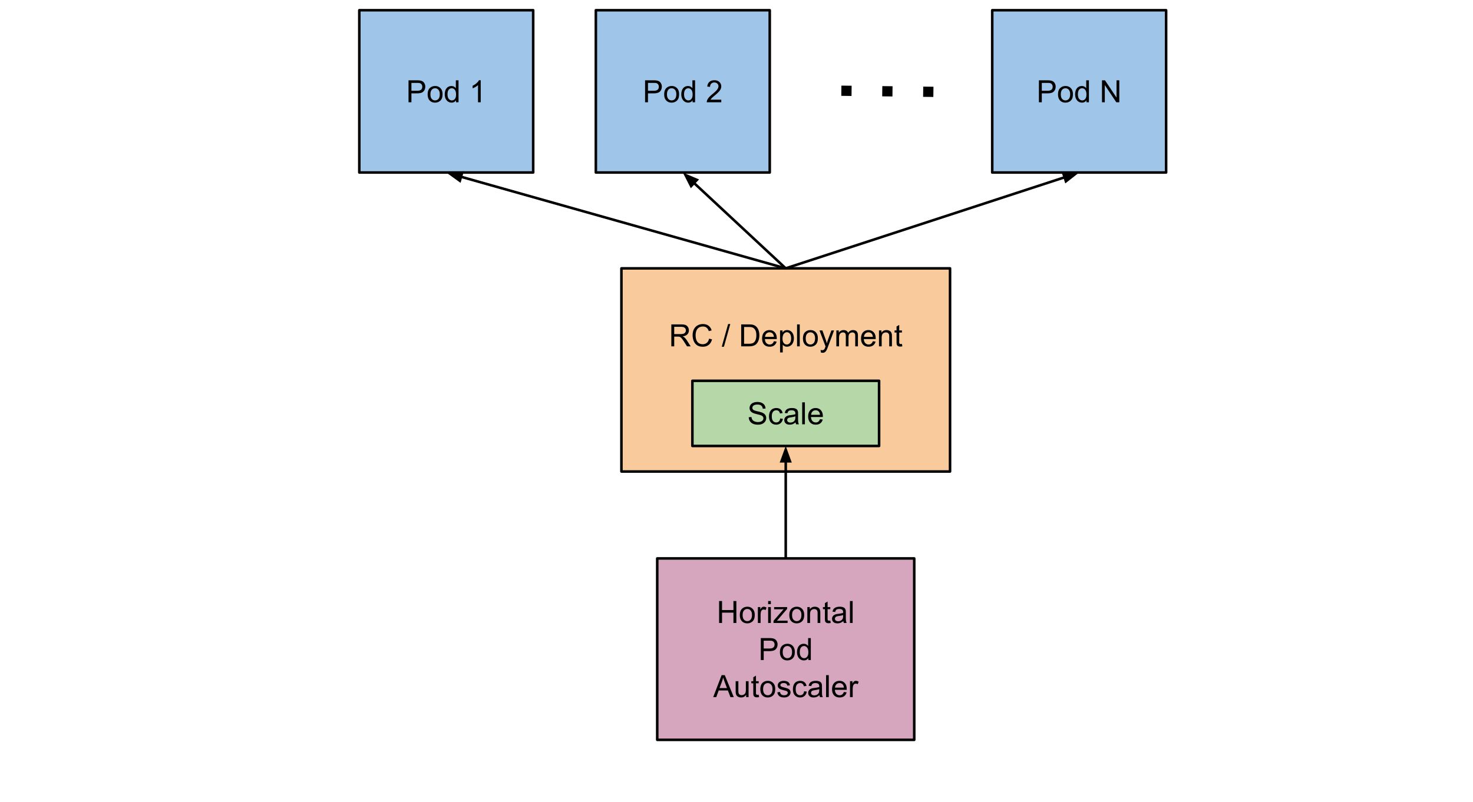
Horizontal Pod Autoscaler
kubectl autoscale deployment nginx --cpu-percent=50 --min=1 --max=10

Slide 24

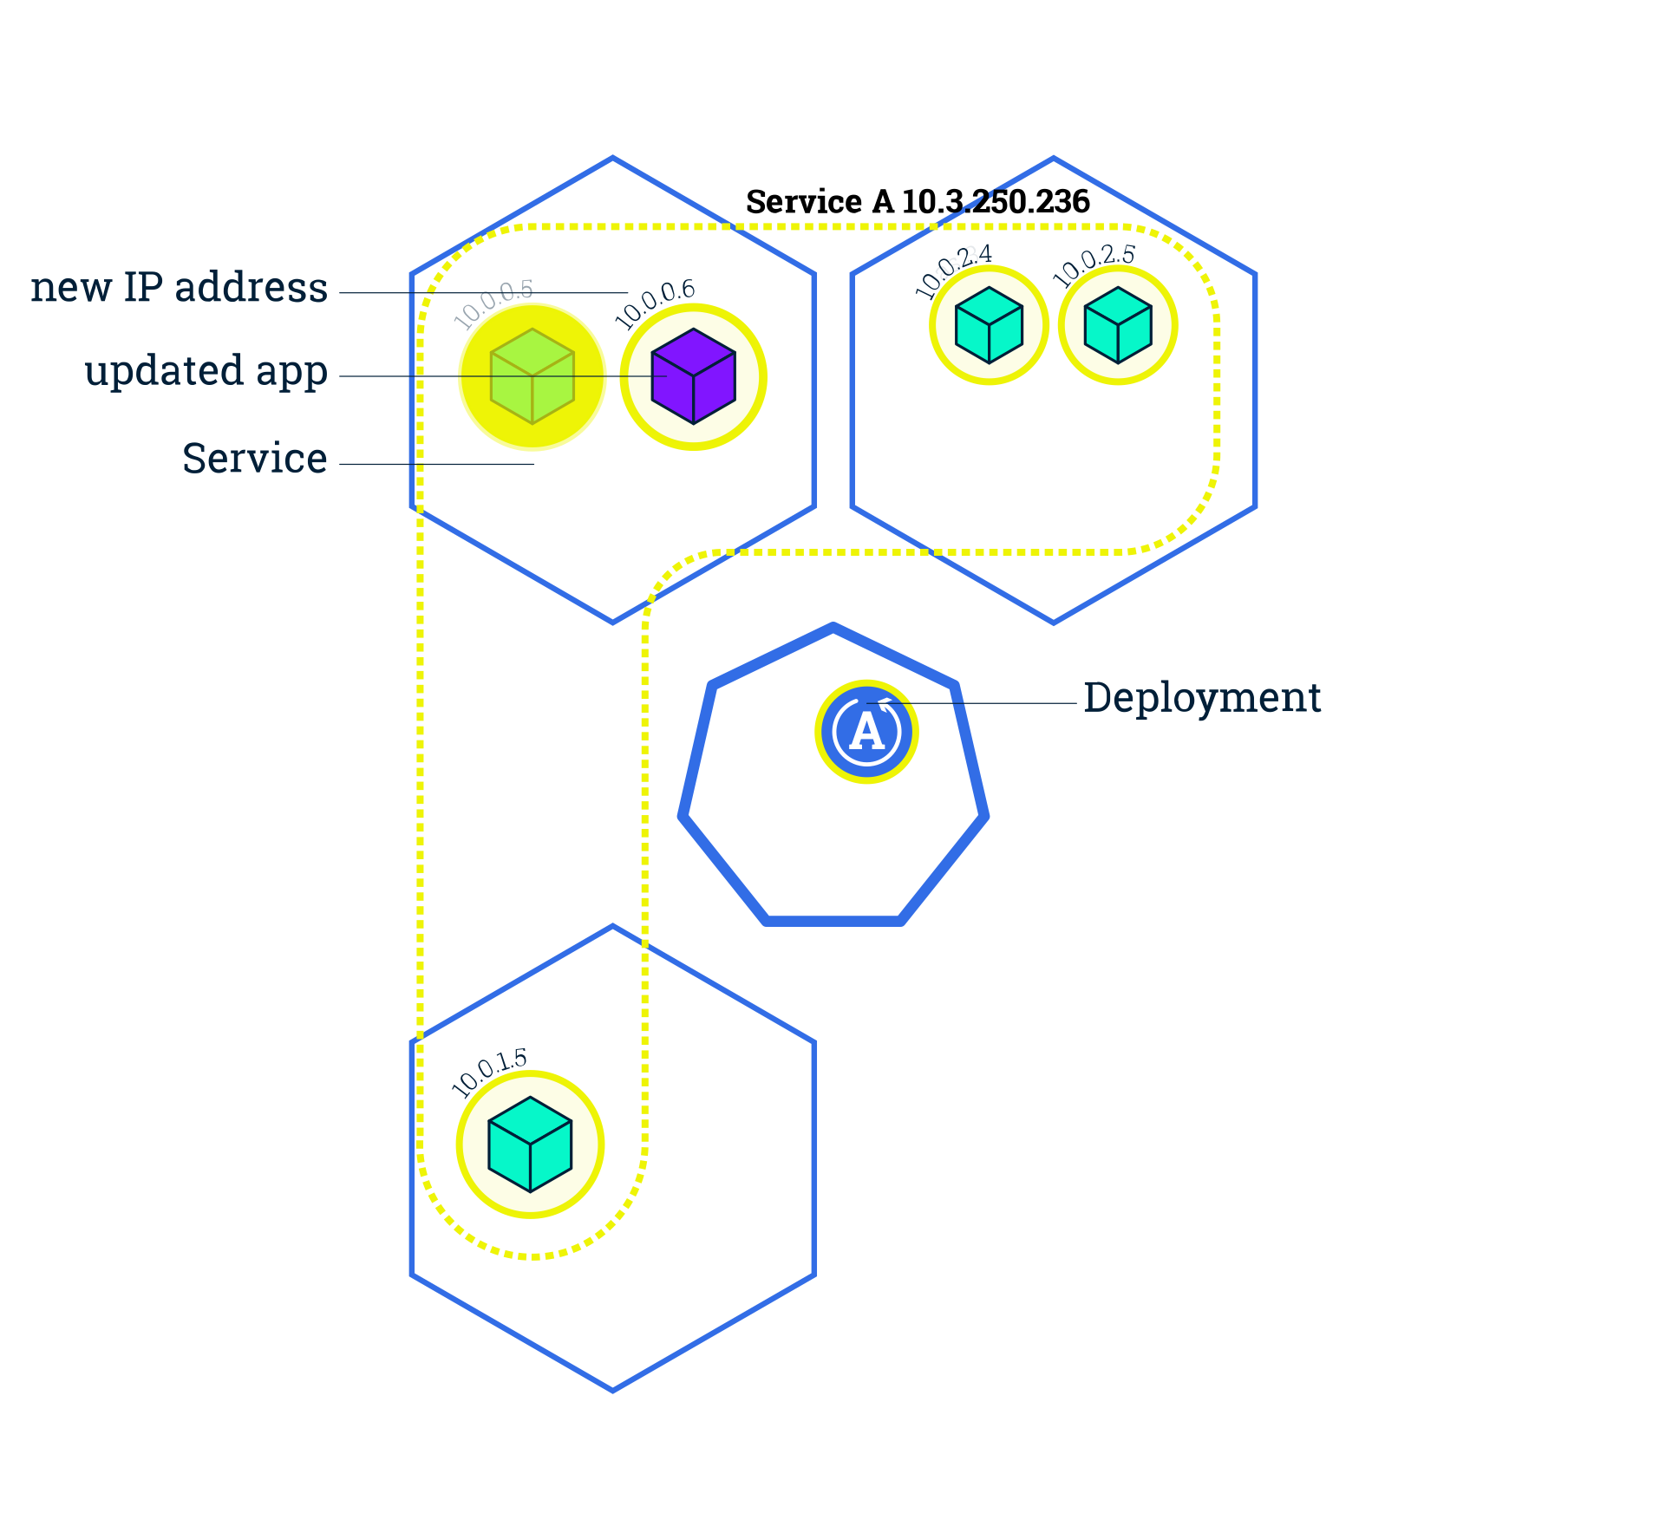
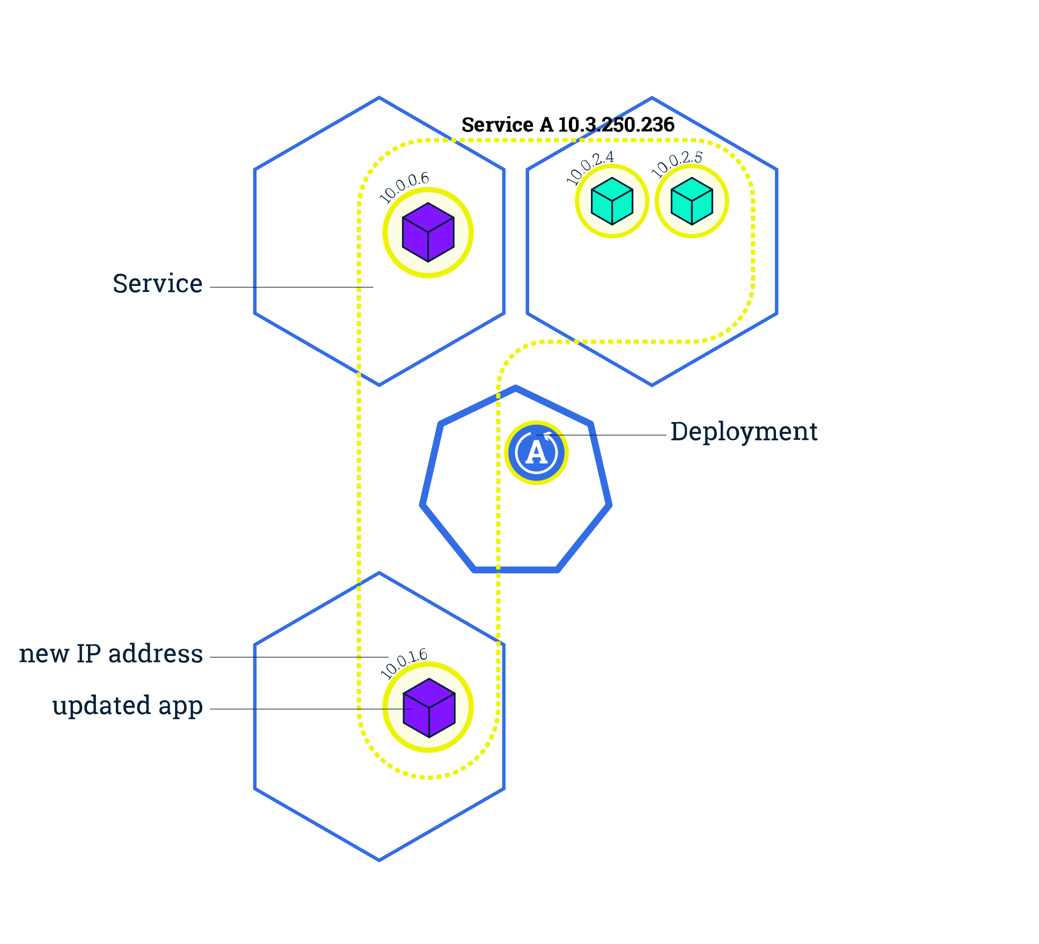
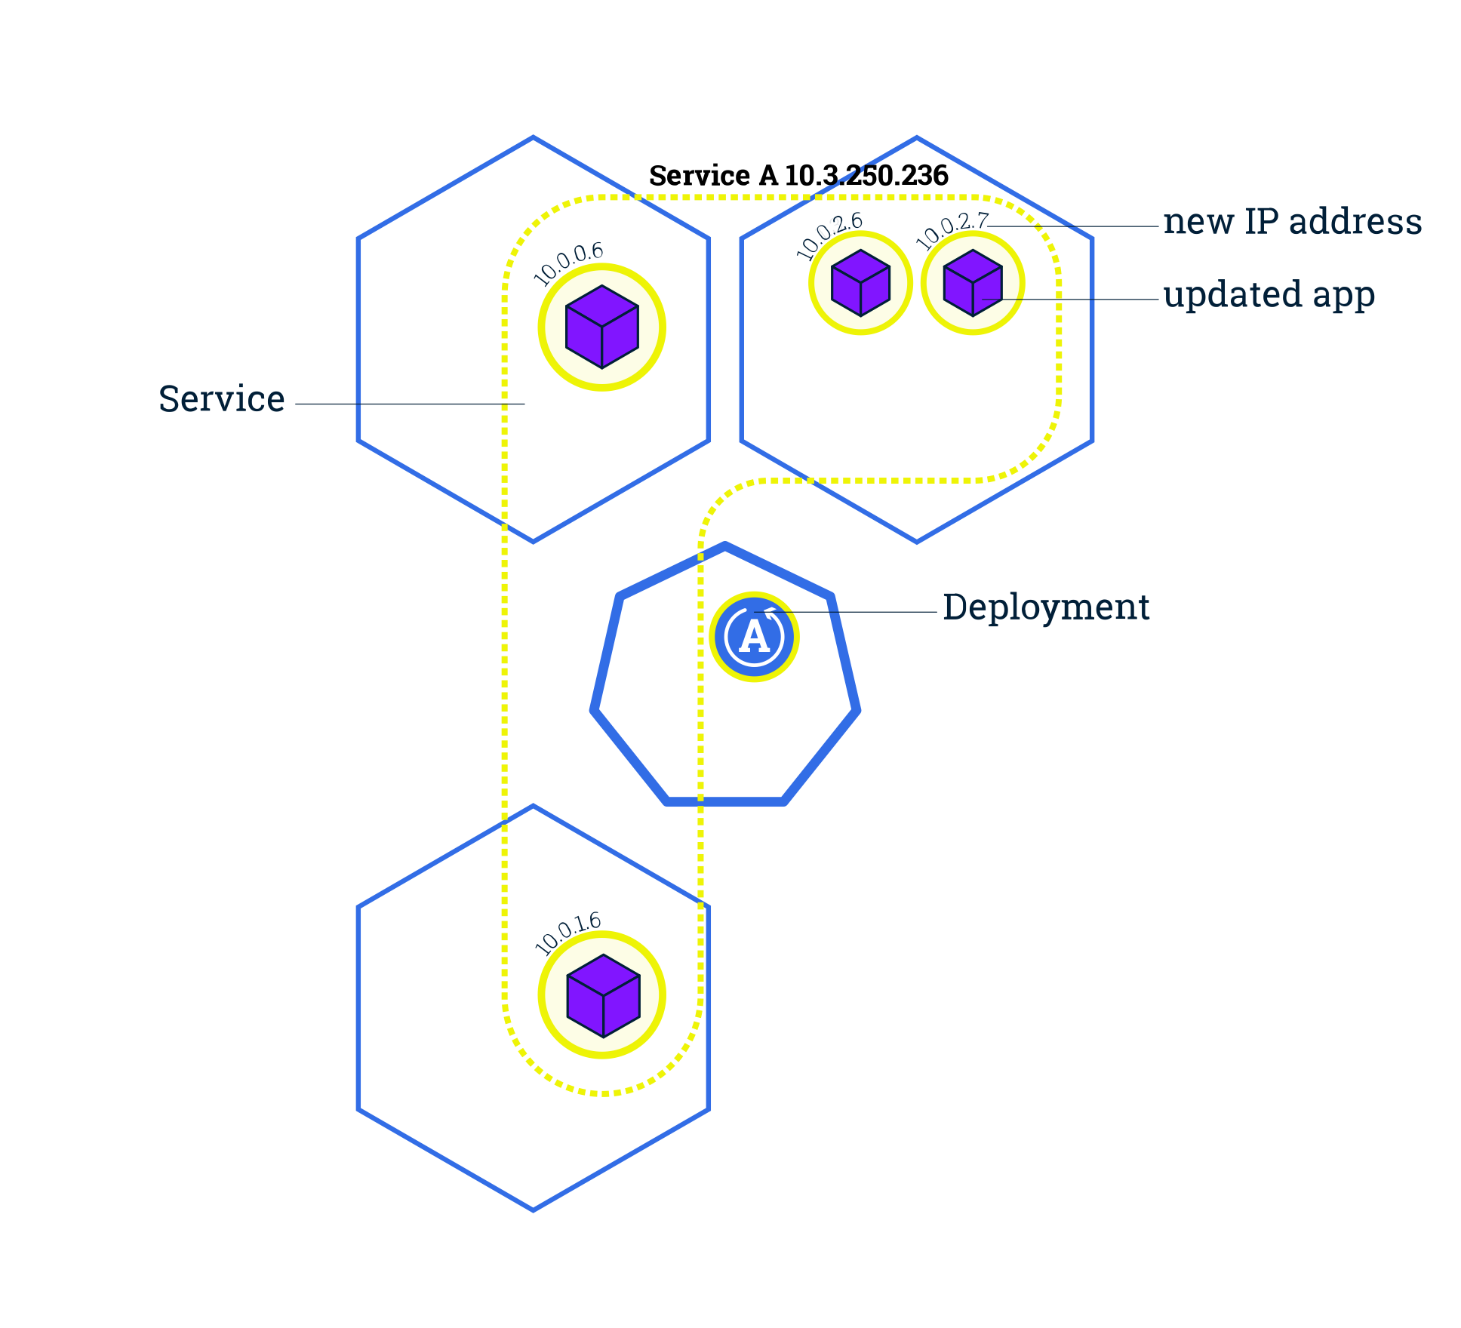
Rolling update
kubectl set image deployment/frontend container1=image:v2

Slide 25
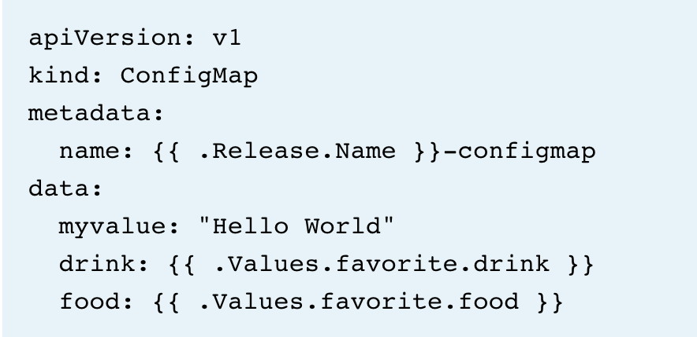
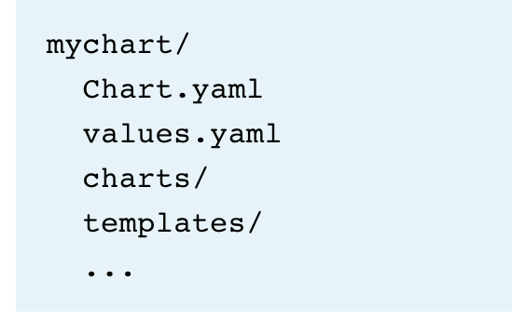
Helm
The package manager for Kubernetes

Slide 26
Service Mesh

Slide 27
What is needed for Microservices to be production ready?
Visibility
Resiliency & Efficiency
Traffic Control
Security
Policy Enforcement
Currently Applications does all this in one form or the other
Retries
Write Logs
In built optimizations
Configurations
Whom to communication
Versioning
Encryptions
Upgrades
Rollbacks
Developers need to take care of things, they are not expert in!
Application end up performing more of everything else than the actual logic.

Slide 28
Business Logic
Business Logic
Operational Logic
Application
Operational Logic
Application
Service Mesh

Slide 29
What is a Service Mesh
Dedicated Infrastructure Layer for handling service-to-service communication.
It’s responsible for the reliable delivery of requests through complex topology of services that makes up a modern cloud native application.
Service mesh is typically implemented as an array of lightweight network proxies that are deployed with the individual services!
Application doesn’t know about them!
It's the communication between software components made into its own thing

Slide 30
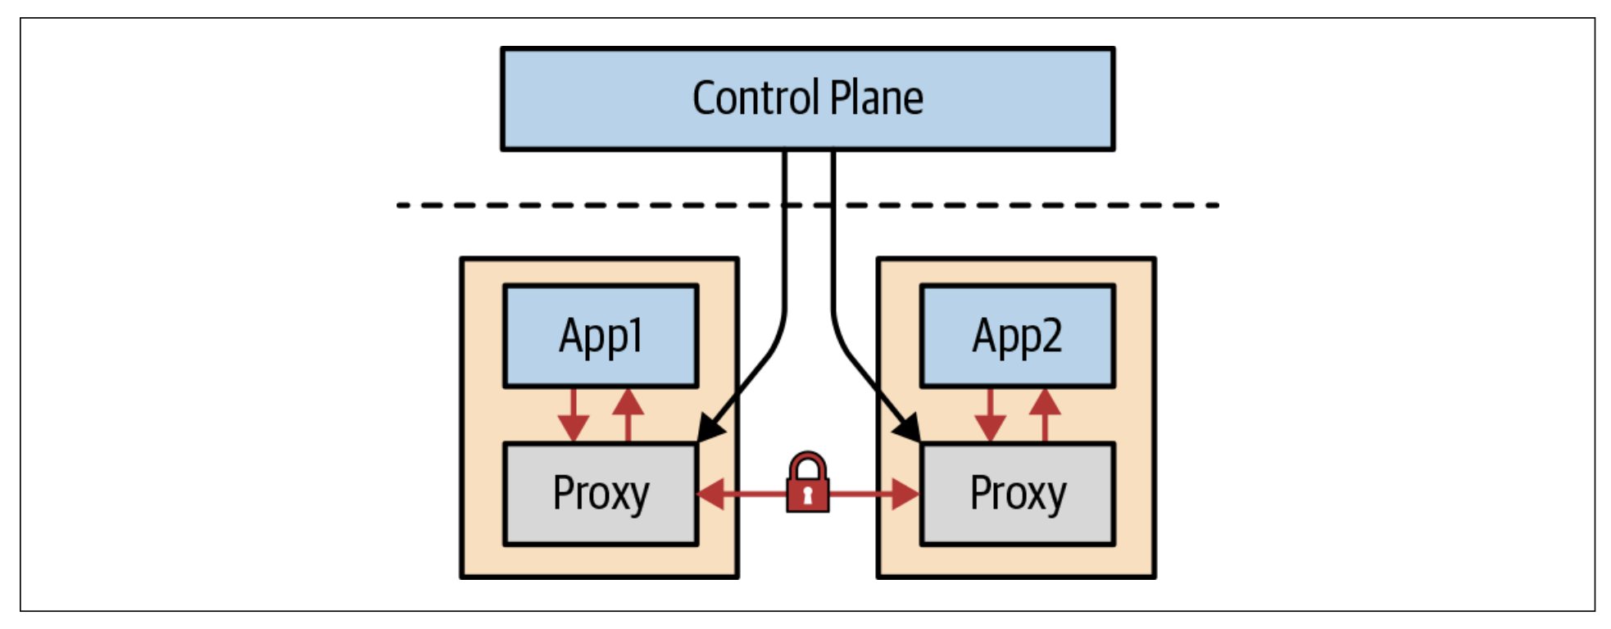
Core of a Service Mesh

Slide 31
Key Features of a Service Mesh
Discovery
Load Balancing
Failure Handling
01
Encryption
Authentication
Authorization
02
Visualization
Tracing
Monitoring Logging
03
Traffic Management
Security
Observability
Notes:
Traffic Management. Control the flow of traffic and API calls between services, make calls more reliable, and make the network more robust in the face of adverse conditions.
● Observability. Gain understanding of the dependencies between services and the nature and flow of traffic between them, providing the ability to quickly identify issues.
● Policy Enforcement. Apply organizational policy to the interaction between services, ensure access policies are enforced and resources are fairly distributed among consumers. Policy changes are made by configuring the mesh, not by changing application code.
● Service Identity and Security. Provide services in the mesh with a verifiable identity and provide the ability to protect service traffic as it flows over networks of varying degrees of trustability.

Slide 32

ISTIO (Greek for Sail)
Open source, platform agnostic service-mesh
Sponsored by IBM, Google & Lyft
Written in Go
0.1 in 2017, 1.0 in 2018, Google primary contributor
Let’s you connect, control and observe services and works great with Kubernates!
Most popular. Other meshes - Consul, Linkerd

Slide 33
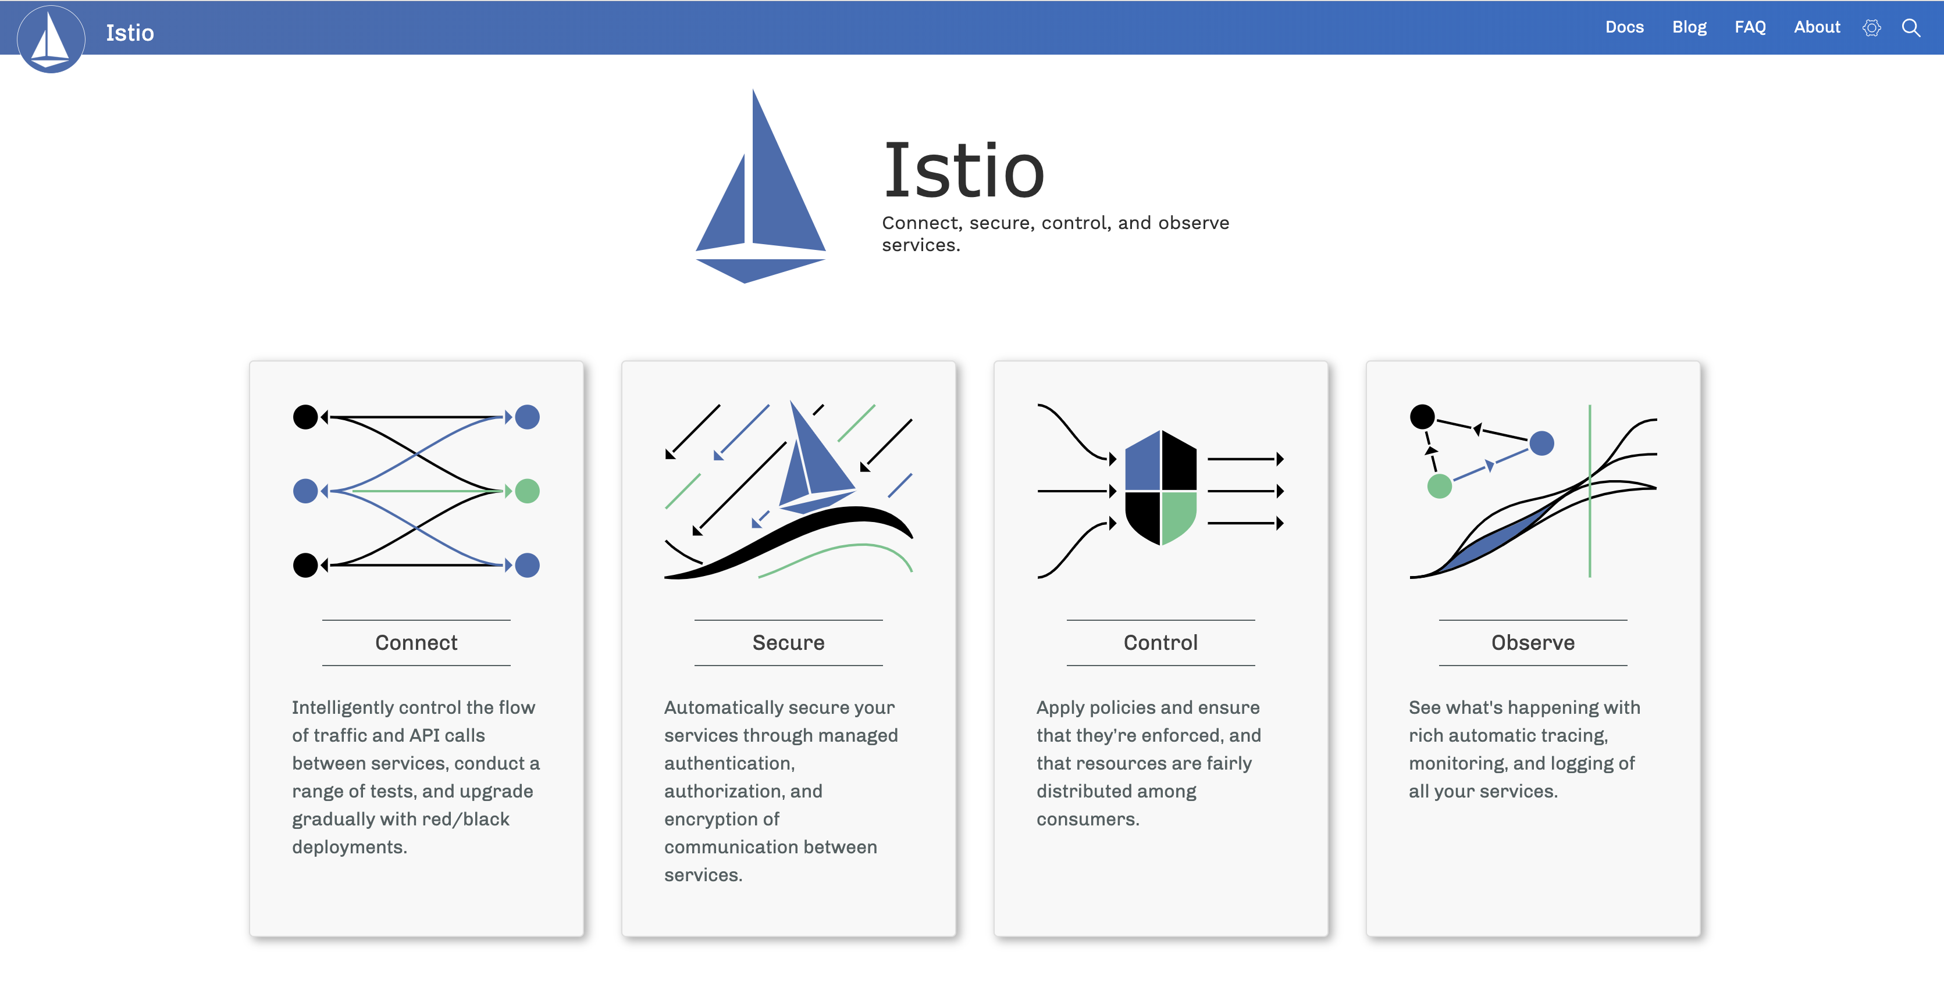
Notes:
Open source platform independent service mesh that
Traffic Management
Policy Enforcement
Telemetry Collection
Runs on
Kubernetes
Nomad
Console
*Service mesh is a network of microservices
Communication (data plan)
Control plane

Slide 34
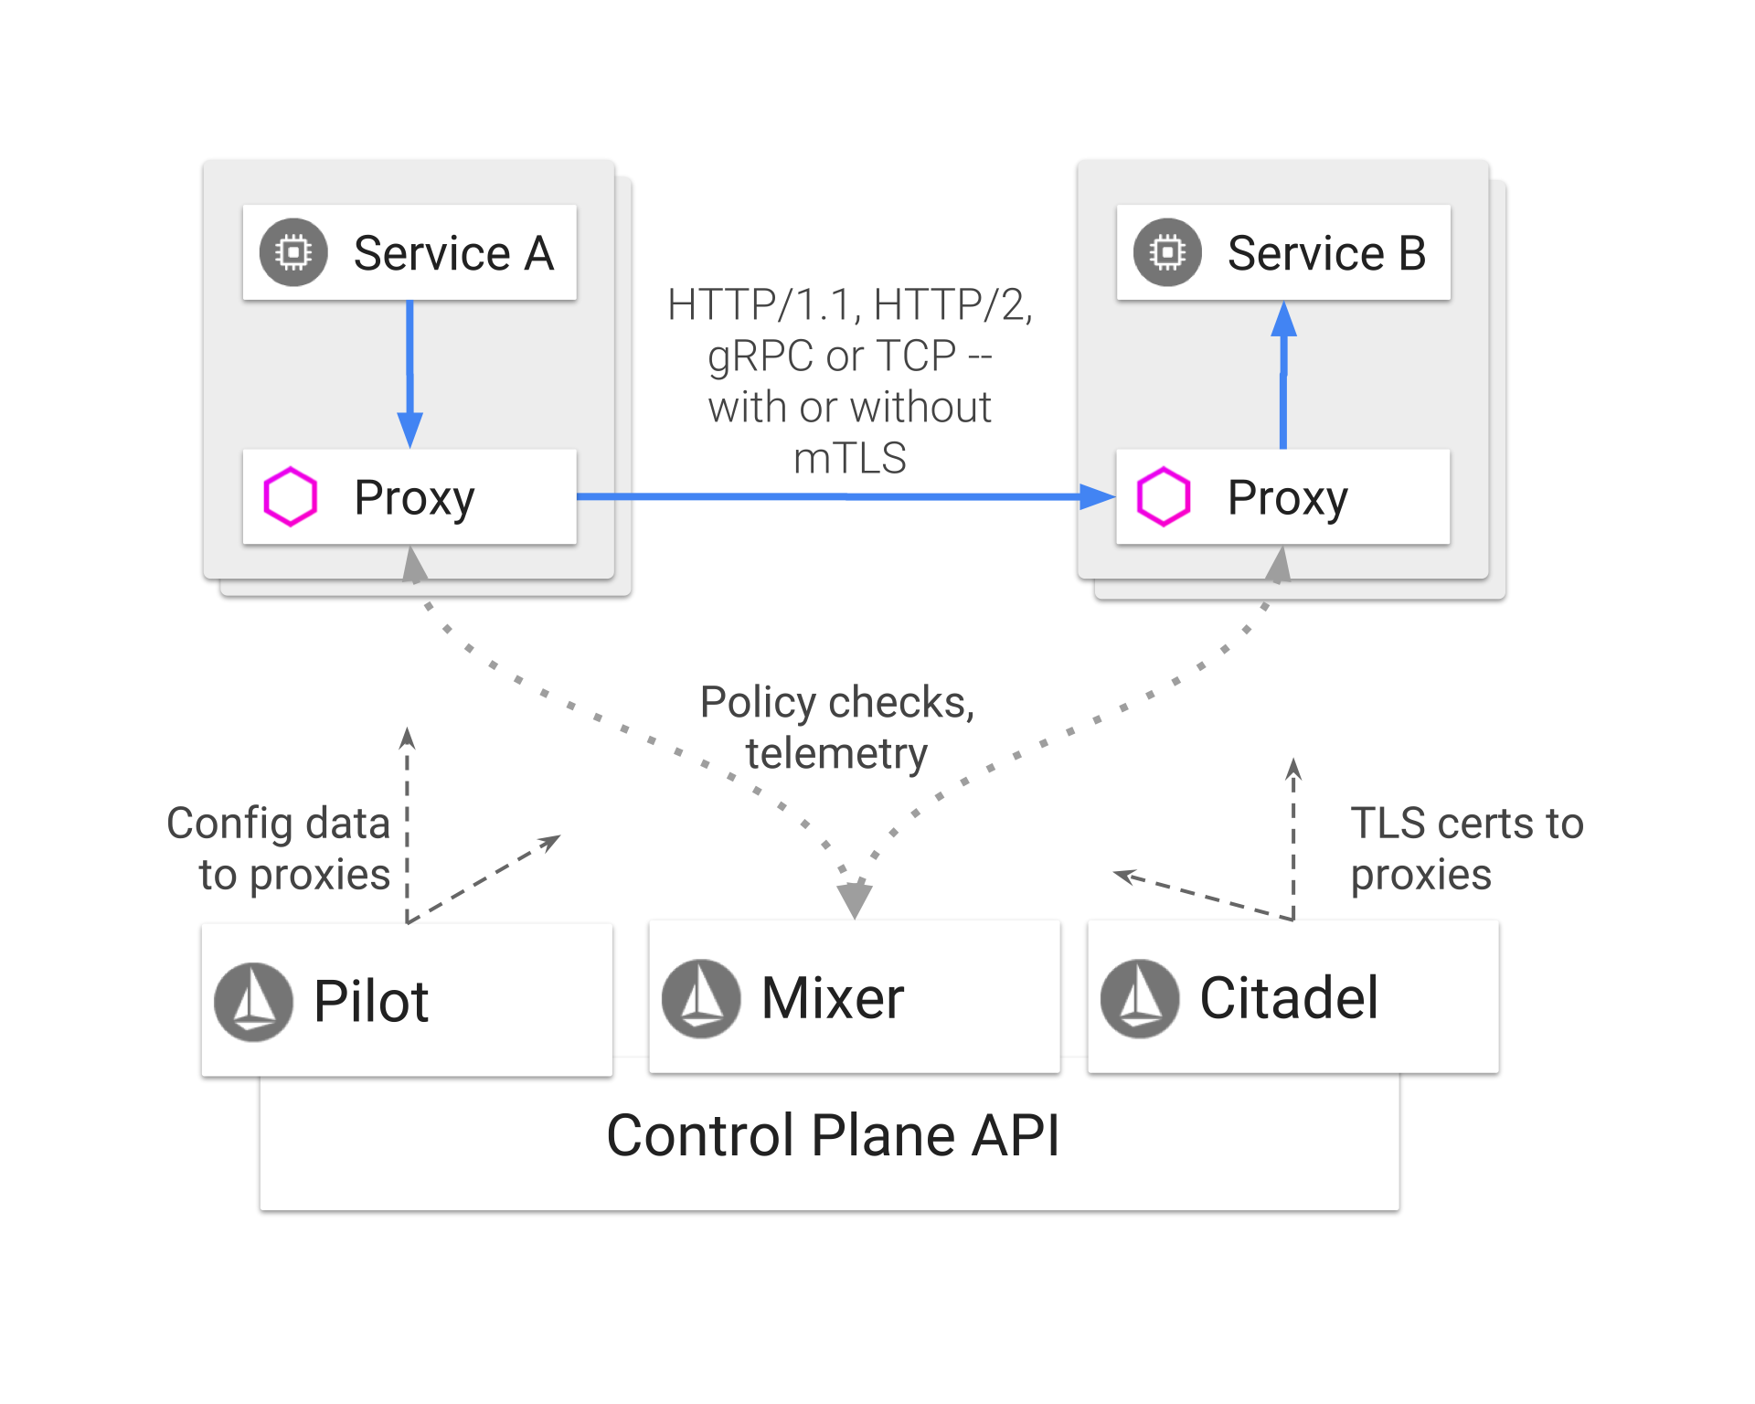
Istio Architecture
Mixer
Enforces access control and usage policies
Collects telemetry data
Proxies send request level attributes which mixer evaluates
Pilot
Provides service discovery to sidecars
Controls traffic routing rules and pushes them to proxies at runtime
Provides resiliency (timeouts, retries..)
Citadel
Built-in identity and credential management (CA)
Service-to-service and end-user authentication
Encryption

Slide 35
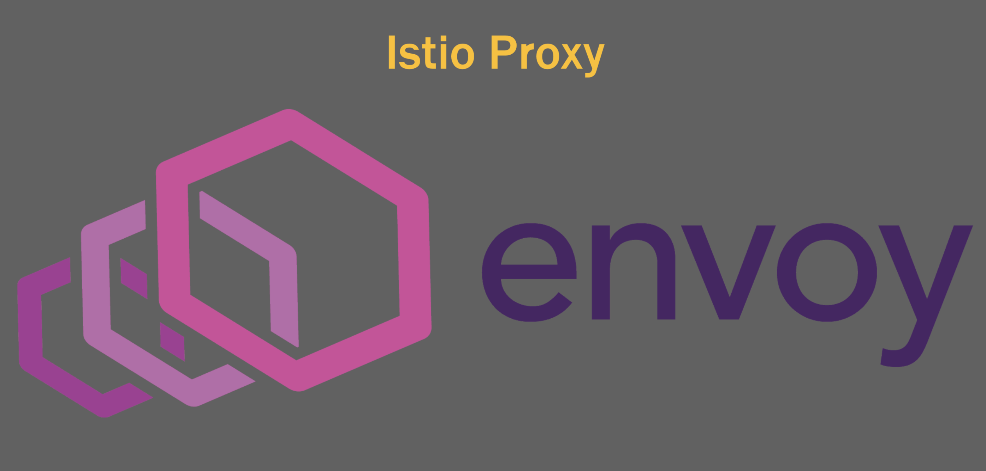
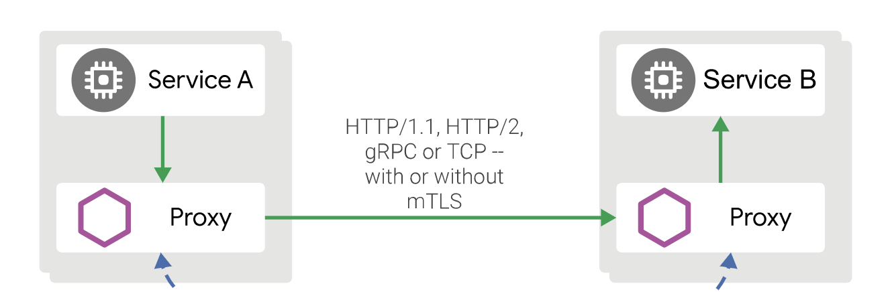
ISTIO Data Plane – Proxy
Istio uses an extended version of the Envoy proxy. Envoy is a high-performance proxy that mediates all incoming and outgoing traffic for all services in the service mesh. Istio leverages Envoy’s many built-in features, for example:
Dynamic service discovery
Load balancing
TLS termination
Circuit breakers
Health checks
Staged rollouts with %-based traffic split
Fault injection
Rich metrics

Slide 36
ISTIO Data Plane – Proxy
Envoy is deployed as a sidecar to a service on a same Kubernates pod.
All traffic entering and leaving pod is transparently routed via Proxy without requiring any application changes.
This deployment allows ISTIO to extract a wealth of signals about traffic behavior as attributes.
Proxy send these attributes to mixer which then enforces policy decisions
It also sends them to monitoring system
It interacts with Pilot for service discovery and intelligent routing.

Slide 37
Key features of ISTIO
Resiliency & Efficiency
Traffic Control
Policy Enforcement

Slide 38
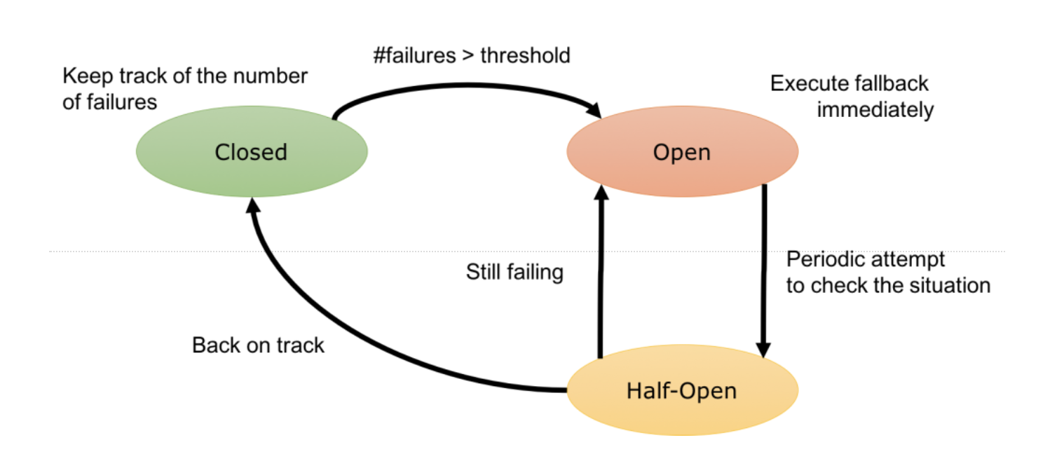
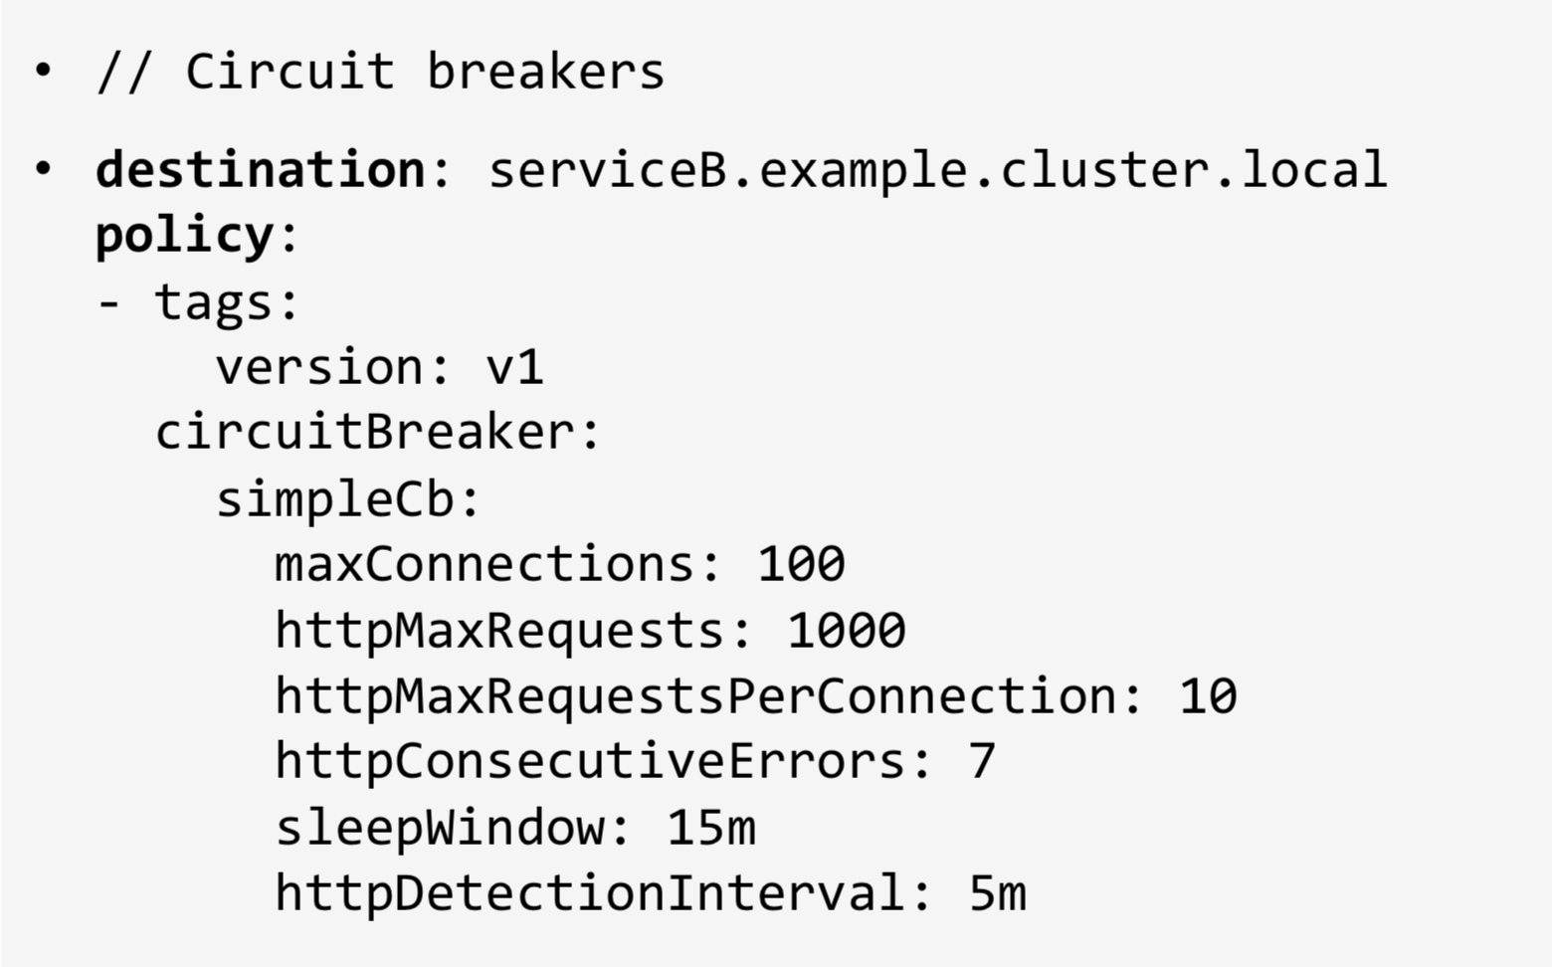

Circuit Breaker
ISTIO adds fault tolerance to your application without any change in the code
Service A
Service B
Proxy
Proxy
Circuit Broke
Notes:
The circuit breaker is a proxy that controls flow to an endpoint. If the endpoint fails or is too slow (based on your configuration), the proxy will open the circuit to the container. In that case, traffic is routed to other containers because of load balancing. The circuit remains open for a preconfigured sleep window (let’s say two minutes) after which the circuit is considered “half-open”. The next request attempted will determine if the circuit moves to “closed” (where everything is working again), or it it reverts to “open” and the sleep window starts again. Here’s a simple State Transition Diagram for the circuit breaker:

Slide 39
Fault Injection
Artificially rejected requests
Artificially induced timeouts
Introduce 5 second delays in 10% of requests
Return HTTP 400 err for 5% of requests
Limit Max connections to 100
Max pending request 200

Slide 40
Key features of ISTIO
Resiliency & Efficiency
Traffic Control
Policy Enforcement

Slide 41
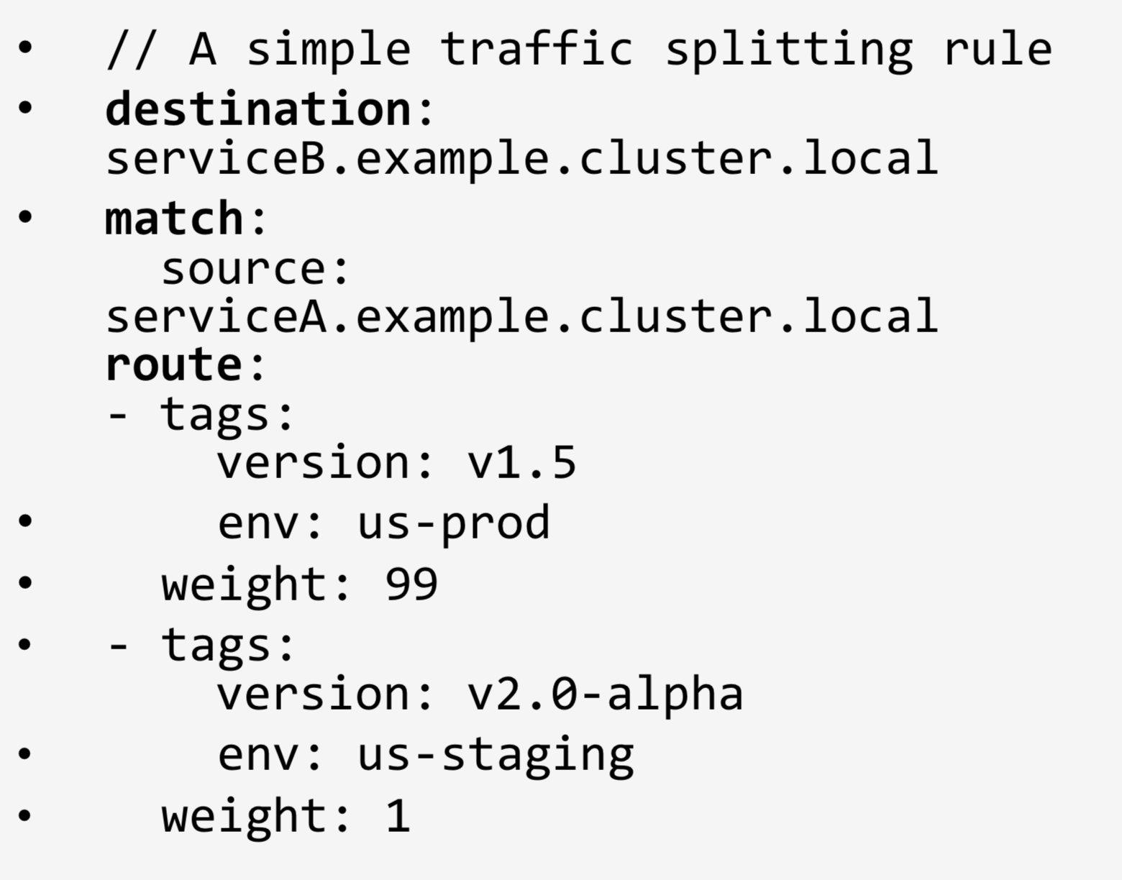
Traffic Splitting
Service B
V 1.5
ISTIO let’s you reroute traffic
Service A
Proxy
99%
Proxy
1%
Service B
V 2.0-alpha
Traffic routing rules
Proxy
ISTIO control plane

Slide 42

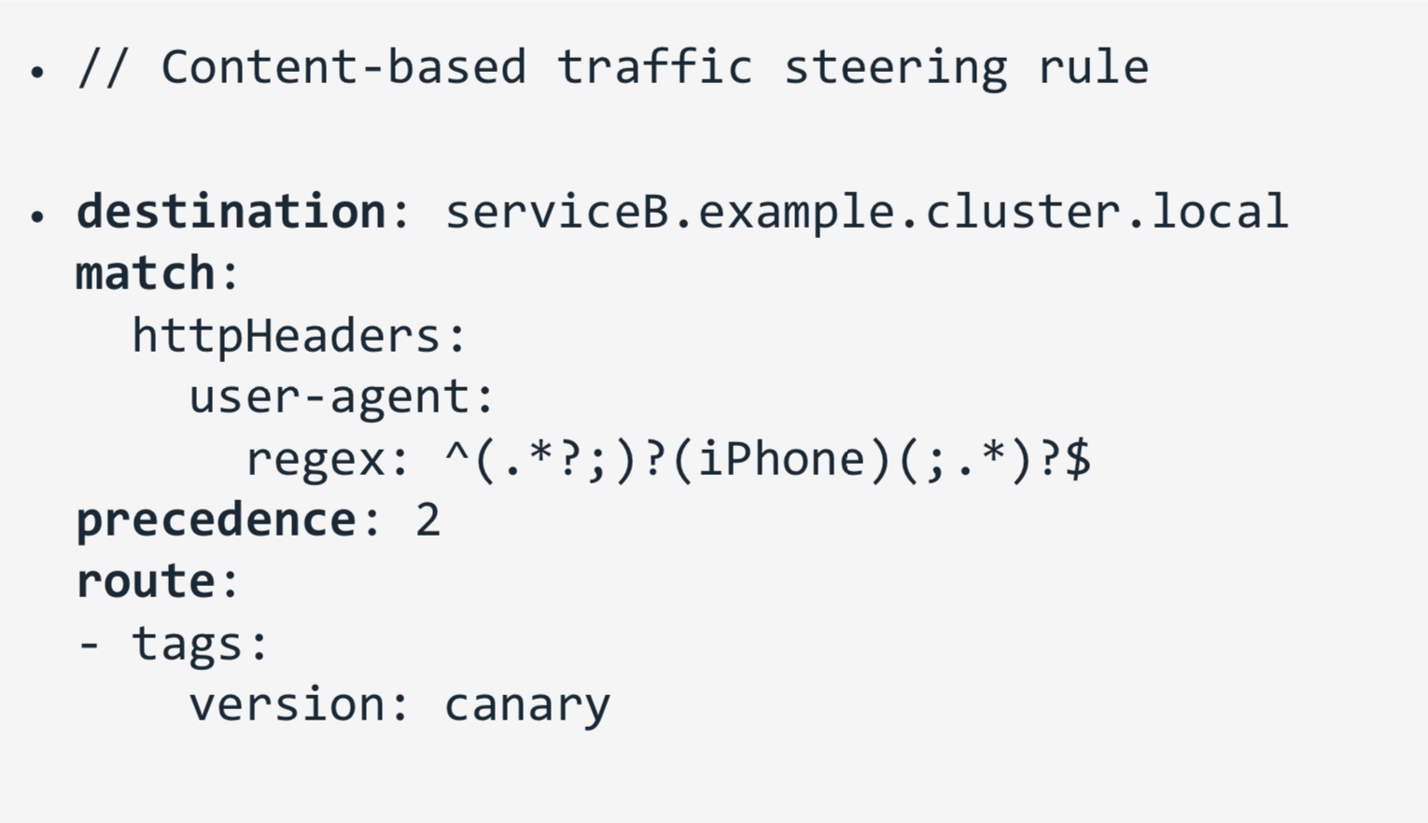

Traffic Steering
Service B
V 1
Steering based on the content
Service A
User-agent: *android*
Proxy
Proxy
Service B
V canary
User-agent: *iPhone*
Traffic routing rules
Proxy
ISTIO control plane

Slide 43
Key features of ISTIO
Resiliency & Efficiency
Traffic Control
Policy Enforcement

Slide 44
Policy Enforcement
Rate Limits / Quotas
Service A can send only 100 requests per min to Service B
Only 2 requests from IP 10.1.12.13 can be accepted in a minute
User X can only send 5 friend requests in an hour.
Control headers and Routing
Intelligent routing based on HTTP headers
Requests coming from Chrome should go to Service B
Denials and White/Black Listing
Halting traffic to a service during upgrade.
Attribute/IP based blocking

Slide 45
Enabling Hybrid cloud

Slide 46
Istio installation and sample lab
https://istio.io/docs/setup/install/standalone-operator/
https://istio.io/docs/examples/bookinfo/

Slide 47
References
https://kubernetes.io/
https://www.ibm.com/cloud/learn/containers
https://www.ibm.com/cloud/garage/courses
https://www.ibm.com/cloud/blog/new-builders/container-orchestration-explained
https://www.cncf.io/
https://cloud.ibm.com/docs/containers?topic=containers-kube_concepts
https://developer.ibm.com/patterns/istio-for-multi-clusters-across-iks-and-icp/
https://www.ibm.com/downloads/cas/XWN1WV9Q
https://helm.sh/

